Slide 1
Digital Systems
18B11EC213
SOP and POS Form

Slide 2
Standard Forms
Certain types of Boolean expressions lead to gating networks which are desirable from implementation viewpoint.
Two Standard Forms: Sum-of-Products and Product-of-Sums
Literals: a variable on its own or in its complemented form. Examples: x, x' , y, y'
Product Term: a single literal or a logical product (AND) of several literals.
Examples: x, x.y.z', A'.B, A.B

Slide 3
Sum Term: a single literal or a logical sum (OR) of several literals.
Examples: x, x+y+z', A'+B, A+B
Sum-of-Products (SOP) Expression: a product term or a logical sum (OR) of several product terms.
Examples: x, x+y.z', x.y'+x'.y.z, A.B+A'.B'
Product-of-Sums (POS) Expression: a sum term or a logical product (AND) of several sum terms.
Examples: x, x.(y+z'), (x+y').(x'+y+z), (A+B).(A'+B')

Slide 4
Minterm & Maxterm
Consider two binary variables x, y.
Each variable may appear as itself or in complemented form as literals (i.e. x, x' & y, y' )
For two variables, there are four possible combinations with the AND operator, namely:
x'.y', x'.y, x.y', x.y
These product terms are called the minterms.
A minterm of n variables is the product of n literals from the different variables (One literal from each variable).

Slide 5
Minterm & Maxterm
In general, n variables can give 2^{n} minterms.
In a similar fashion, a maxterm of n variables is the sum of n literals from the different variables.
Examples: x'+y', x'+y, x+y', x+y
In general, n variables can give 2^{n} maxterms.

Slide 6
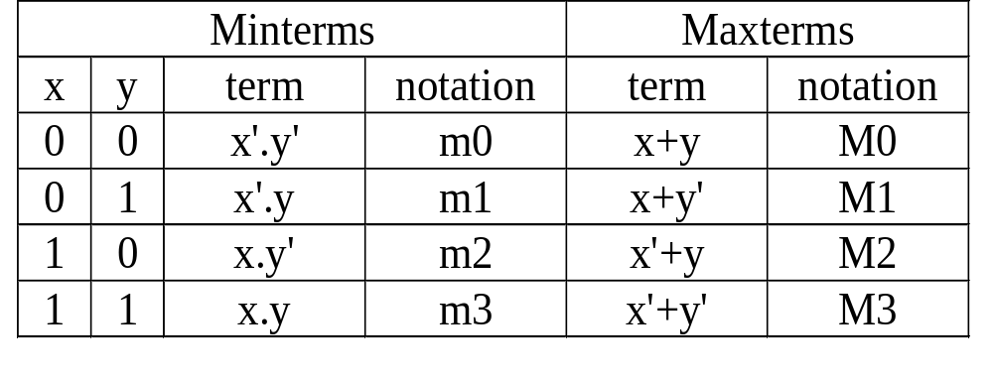
Minterm & Maxterm
The minterms and maxterms of 2 variables are denoted by m0 to m3 and M0 to M3 respectively:
Each: Minterm is the complement of the corresponding maxterm:
Example: m₂ = x.y'
m₂' = (x.y')' = x' + (y')' = x'+y = M2

Slide 7
Canonical Form: Sum of Minterms
What is a canonical/normal form?
  A unique form for representation.
Minterms are product terms.
  Can express Boolean functions using Sum-of-Minterms form.

Slide 8
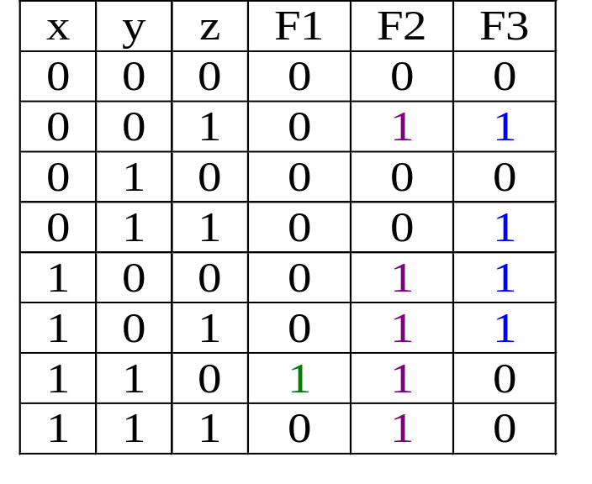
Canonical Form: Sum of Minterms
Obtain Sum-of-Minterms by gathering/summing the minterms of the function (where result is a 1)
F1 = x.y.z' = Σm(6)
F2 = x'.y'.z + x.y'.z' + x.y'.z + x.y.z' + x.y.z
= Σm(1,4,5,6,7)
F3 = x'.y'.z + x'.y.z
+ x.y'.z' +x.y'.z
= Σm(1,3,4,5)

Slide 9
Canonical Form: Product of Maxterms
Maxterms are sum terms.
For Boolean functions, the maxterms of a function are the terms for which the result is 0.
Boolean functions can be expressed as Products-of-Maxterms.

Slide 10
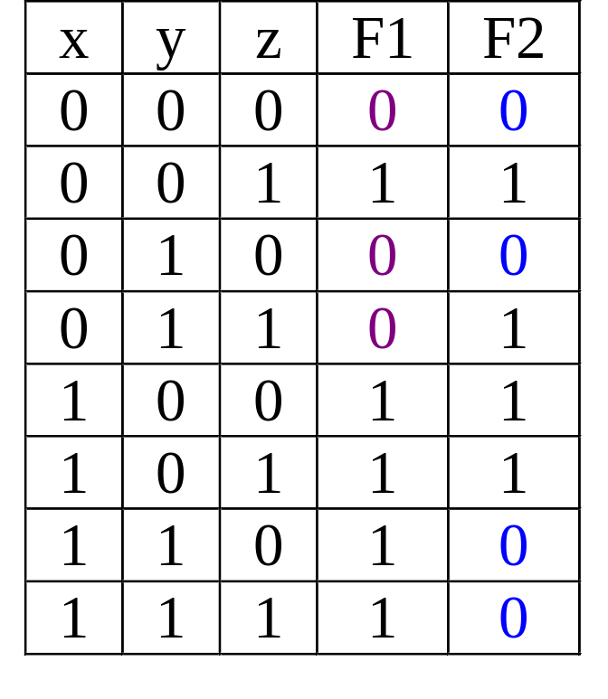
Canonical Form: Product of Maxterms
F1(x,y,z) = ΠM(0,2,3) = (x+y+z).(x+y'+z).(x+y'+z')
F2(x,y,z) = ΠM(0,2,6,7)
= (x+y+z).(x+y'+z).(x'+y'+z).(x'+y'+z')

Slide 11
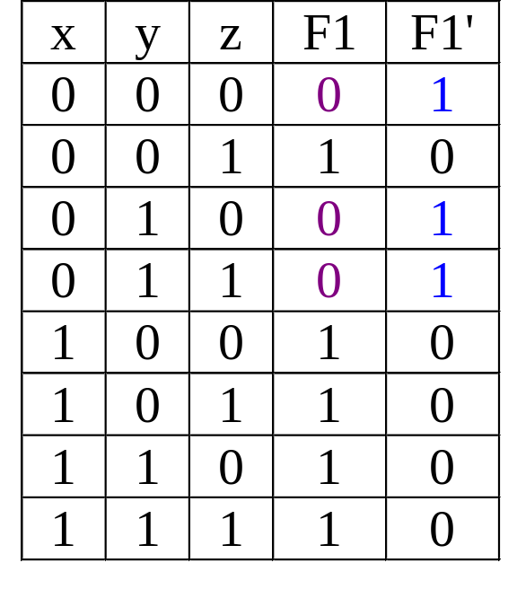
Complement of a Function
Take F1 as an example.
F1 = Σm(1,4,5,6,7) or ΠM(0,2,3)
The complement function of F1 is:
F1' = Σm(0,2,3) or ΠM(1,4,5,6,7)

Slide 12
Expansion of a Boolean Expression
Expand, F(A,B,C,D) = A+BC' +ABD' + ABCD to minterms and maxterms.
First term is A (variables B, C and D are missing)
A = A(B+B')(C+C')(D+ D') = ABCD + ABCD' + ABC'D + ABC'D' +AB'CD + AB'CD' + AB'C'D + AB'C'D' = Σm(8,9,10,11,12,13,14,15)
Second term is BC' (variables A and D are missing)
BC' = BC'(A+A')(D+D') = ABC'D + ABC'D' + A'BC'D + A'BC'D' =Σm(4,5,12,13)
Third term is ABD' (variable C is missing)
ABD' = ABD'(C+C') = ABCD' + ABC'D' = Σm(12,14)
Last term is ABCD (none of the variables is missing), ABCD = Σm(15)
F(A,B,C,D) = Σm(4,5,8,9,10,11,12,13, 14, 15) (Sum of minterms)
F(A,B,C,D) = ΠM(0,1,2,3,6,7) (Product of maxterms)

Slide 13
Expansion of a Boolean Expression
Expand, F(A,B,C) = A(A'+B)(A'+B+C') to minterms and maxterms.
First term is A (variables B and C are missing)
A = A+BB' = (A+B)(A+B') = (A+B+CC')(A+B'+CC')
= (A+B+C)(A+B+C')(A+B'+C)(A+B'+C') = ΠM(0,1,2,3)
Second term is (A' +B) (variable C is missing)
(A'+B) = (A'+B+CC') =(A'+B+C)(A'+B+C') = ΠM(4,5)
Last term is (A'+B+C') (none of the variables is missing), (A'+B+C') = ΠM(5)
F(A,B,C) = ΠM(0,1,2,3,4,5) (Product of maxterms)
F(A,B,C) = Σm(6,7) (Sum of minterms)

Slide 14
References
A. Anand Kumar, “Fundamentals of Digital Circuits”, PHI, Fourth Edition.
S. Salivahanan and S. Arivazhagan, “Digital circuits and design”, Vikas Publishing House PVT Limited, Fifth edition.

